Slide 1




ISWC2014 Tutorial on Large Scale Reasoning Over Semantic Data
Presenters:
Jeff Z. Pan (University of Aberdeen)
Raghava Mutharaju (Wright State University)
Ilias Tachmazidis (University of Huddersfield)
Guilin Qi (Southeast University)

Slide 2
Agenda
9:10am – 9:45am
Motivations and Overview of Background Knowledge (Jeff, Ilias)
9:45am – 10:30am
Scalable OWL 2 DL reasoning based on approximation and divide-and-conquer approaches (Jeff)
10:30am – 11:00am
Coffee break
11:00am – 11:45am
Distributed Reasoning in OWL 2 EL (Raghava)
11:45am – 12:30pm
Large Scale Non-Monotonic Reasoning (Ilias)

Slide 3
Agenda
2:00pm – 2:45pm
Scalable RDFS Reasoning Using MapReduce (Raghava)
2:45pm – 3:30pm
Applications (Raghava, Jeff)
3:30pm – 4:00pm
Coffee break
4:00pm – 4:45pm
Lesson Learned and Conclusions (Jeff, Raghava)

Slide 4

Motivation and Overview
Motivation
Why reasoning over semantic data
Why large scale reasoning
Overview
RDF reasoning
OWL reasoning
Parallelisation frameworks

Slide 5
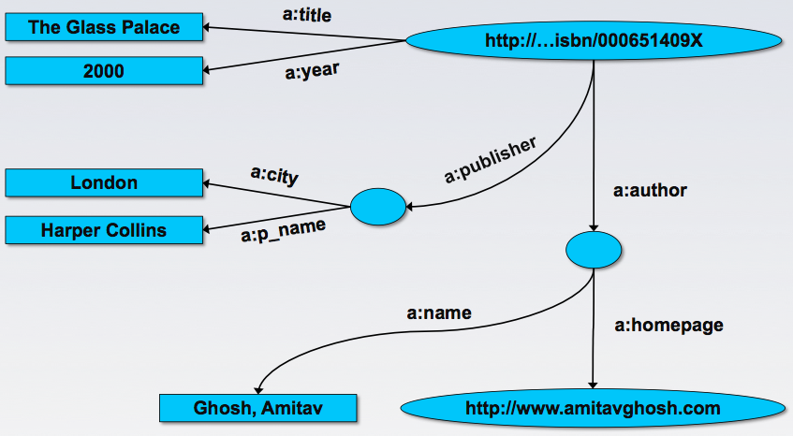

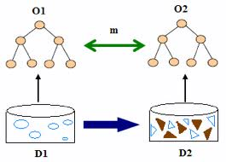
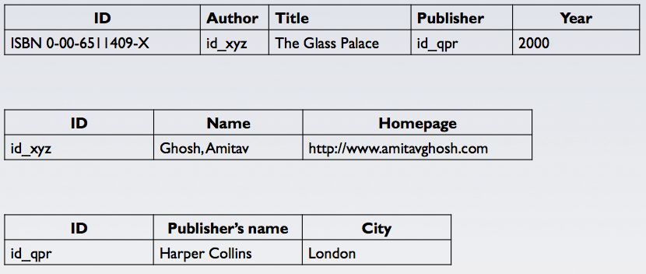
Semantic data integration
annotate ontological vocabulary
Map the data onto RDF triples (data unit)
[credit: Ivan Herman]
5

Slide 6
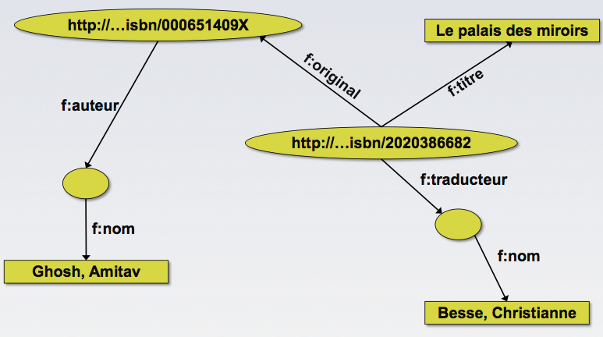

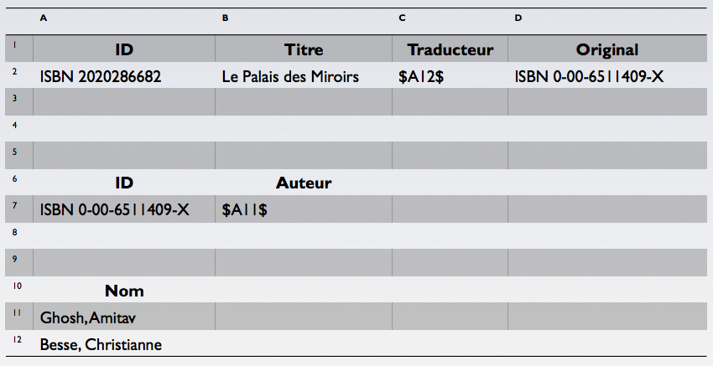
Same Book in French
[credit: Ivan Herman]
6

Slide 7
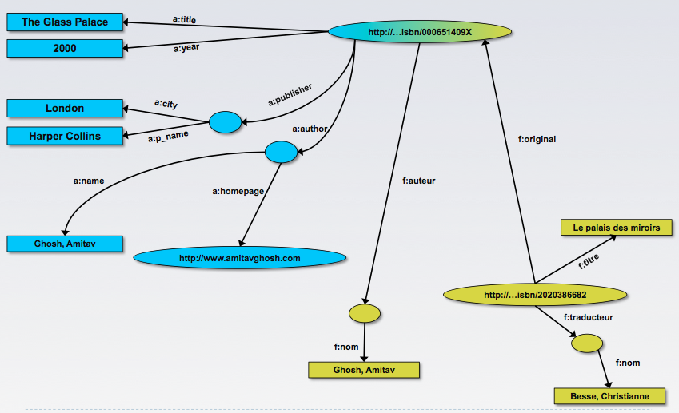
Merging the Data
Give me the title of the original
well, ... « donnes-moi le titre de l’original »
[credit: Ivan Herman]
7

Slide 8
SPARQL: Standard Query Language for Semantic Data
PREFIX a: http://www.example.com/a/
PREFIX f: http://www.example.com/f/
PREFIX book: <http://www.example.com/book/> SELECT ?book ?title FROM <http://www.example.org> WHERE { http://... 386682 f:original ?book . ?book a:title ?title. }

Slide 9
Making Use of Reasoning
PREFIX a: http://www.example.com/a/
PREFIX f: http://www.example.com/f/
PREFIX book: <http://www.example.com/book/> SELECT ?book ?homepage FROM <http://www.example.org> WHERE { http://... 386682 f:original ?book . ?book f:auteur ?author. ?author a:homepage ?homepage
}
“give me the homepage of the original’s ‘auteur’”
owl:sameAs
[credit: Ivan Herman]
9

Slide 10
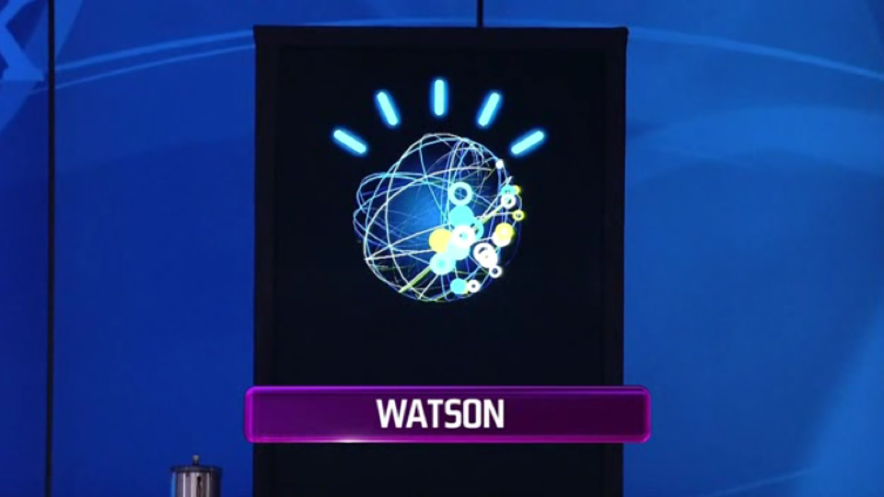
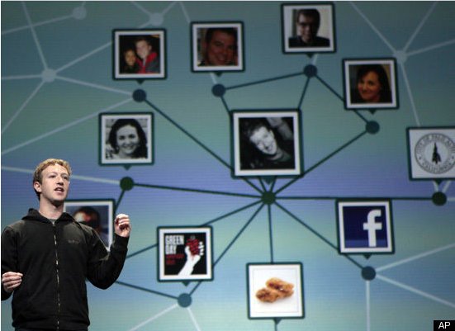
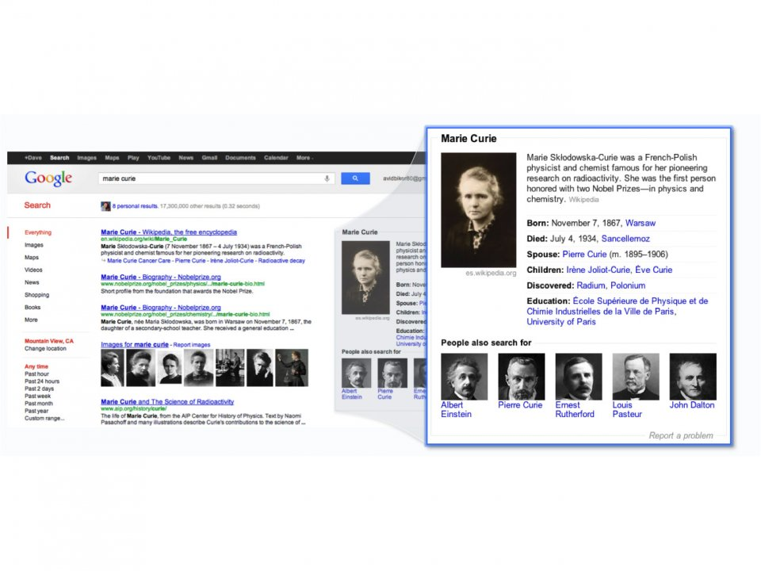
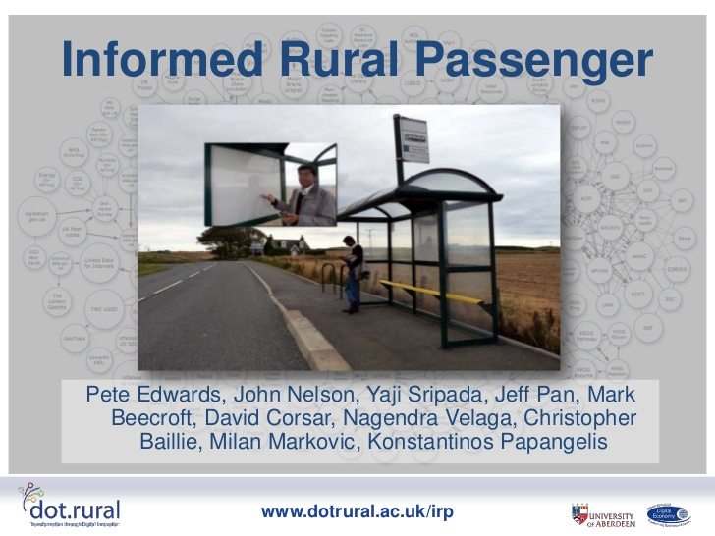
The need for bridging the gap between data and queries
Question Answering
Social Discovery
Semantic Search
Digital Economy
10

Slide 11
Reasoning with RDF Schema
[rdfs2]
[p rdfs:domain C .] [a p b .] => [a rdf:type C .]
[rdfs3]
[p rdfs:range D .] [a p b .] => [b rdf:type D .]
[rdfs5]
[p1 rdfs:subPropertyOf p2 .] [p2 rdfs:subPropertyOf p3 .] =>
[p1 rdfs:subPropertyOf p3 .]

Slide 12
Reasoning with RDF Schema(2)
[rdfs7]
[p1 rdfs:subPropertyOf p2 .] [a p1 b .] => [a p2 b .]
[rdfs9]
[C rdfs:subClassOf D .] [b rdf:type C .] => [b rdf:type D .]
[rdfs11]
[C1 rdfs:subClassOf C2 .] [C2 rdfs:subClassOf C3 .] =>
[C1 rdfs:subClassOf C3 .]

Slide 13
Example: Reasoning with RDF Schema
Example entailment rule [rdfs9]:
[b rdf:type C .], [C rdfs:subClassOf D .] => [b rdf:type D .]
Given
[csd:p001 rdf:type csd:Student .]
[csd:Student rdfs:subClassOf csd:Person.]
by applying the above rule, we have
[csd:p001 rdf:type csd:Person.]

Slide 14
How about Primary Key
RDF is NOT expressive enough to represent primary key
We need OWL (Web Ontology Language) for representing primary keys
Example with Friend Of a Friend (FoaF) ontology
foaf:OnlineAccount owl:hasKey
(foaf:accountName
foaf:accountServiceHomepage)

Slide 15
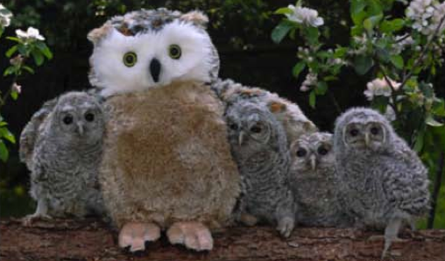
OWL Profiles and Reasoning
Current version of OWL is OWL 2
Based on Description Logics (DLs)
OWL 2 has three tractable (with low computational complexity ) profiles
OWL 2 EL: schema reasoning, instance reasoning and query answering
OWL 2 QL: query answering
OWL 2 RL: the “rule fragment” of OWL 2
Unions of any of the two profiles are no longer tractable

Slide 16
DL Interpretation and Reasoning
An interpretation I is written as (Δ^{I}, •^{I})
Δ^{I} is the domain (similar to universal set)
•^{I} is the interpretation function
all individuals are members of the domain: o^{I} ∈ Δ^{I}
all classes are subsets of the domain A^{I} ⊆ Δ^{I}
all properties are subsets R^{I} ⊆ Δ^{I ×}Δ^{I}
Axioms are used to “filter out” invalid interpretations from valid ones
An interpretation I is a model for an ontology O if it satisfies all its axioms
An ontology O is consistent if it has some model (valid interpretation).

Slide 17

Entailments of Axioms
Entailment (|=): given an axiom α, we say an ontology O entails the axiom α if and only if all interpretation I of O satisfy α.
TBox reasoning
class satisfiability checking
subsumption checking
classification
ABox reasoning
Instance checking
Instance retrieval
Query answering

Slide 18
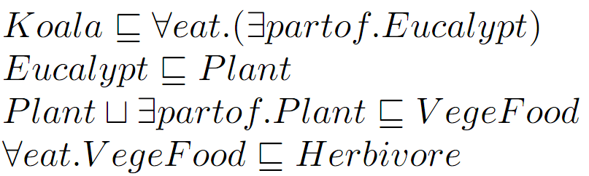
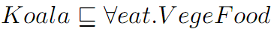
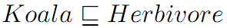
Schema Reasoning: Connecting Vocabulary
Infer implicit knowledge from explicit knowledge
18

Slide 19
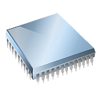
Serial
Reasoning! Large scale?
More data means:
longer processing time
main memory insufficiency

Slide 20
Parallel
Supercomputer
Single machine
Shared memory

Slide 21
Distributed
Cluster of machines
Distributed memory

Slide 22
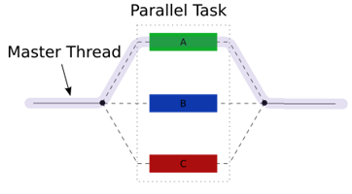
Threads
Pros
developer is in full control
shared memory and distributed memory
allows for cost management
Cons
low level programming
serial to parallel is not easy
hard to implement, change and debug

Slide 23
OpenMP (1/3)
OpenMP = Open Multi-Processing
Multi-threaded, shared memory parallelism
Supports C and Fortran
Oct 1997: Fortran 1.0
Oct 1998: C/C++ 1.0
Since 2005, API specifications for C and Fortran are released together
Current version: OpenMP 4.0

Slide 24
OpenMP (2/3)
Three basic components:
Compiler Directives
#pragma omp parallel
Runtime Library Routines
int omp_get_num_threads(void)
Environment Variables
export OMP_NUM_THREADS=8

Slide 25
OpenMP (3/3)
Pros:
incremental
code works in serial/parallel without adjustments
data decomposition is handled automatically
Cons:
only shared-memory
developer should be aware of parallelization details

Slide 26
GPU (1/4)
GPU = Graphics Processing Unit
Programming frameworks:
CUDA
OpenCL

Slide 27
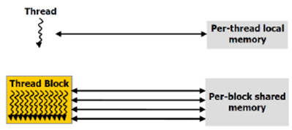
GPU (2/4)
GPUs follows SIMD (Single Instruction, Multiple Data)
Each thread operates over different data
Each thread has local memory
Threads are grouped into thread blocks
Each thread block has a per-block shared memory

Slide 28
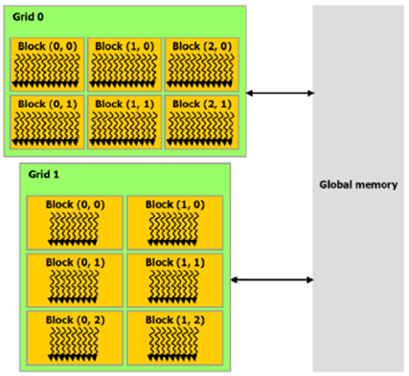
GPU (3/4)
Groups of thread blocks form grids
Each grid can operate over a different set of instructions
Grids have access to global memory
Grobal memory is the main memory of GPU
Host (CPU) and device (GPU) communicate using global memory

Slide 29
GPU (4/4)
Pros:
can utilize up to thousands of GPU cores
low cost
Cons:
only shared memory
developer should be aware of parallelization details
communication between host and device may become a bottleneck

Slide 30
MPI (1/3)
MPI = Message Passing Interface
Specification of message passing libraries.
May 1994: Final version of MPI-1.0 released
Sep 2012: The MPI-3.0 standard was approved
C, C++ and Fortran

Slide 31
MPI (2/3)
Pros:
MPI runs on distributed memory and shared memory
applies to wide range of problems providing a certain level of abstraction
allows for cost management

Slide 32
MPI (3/3)
Cons:
serial to parallel is not easy
hard to debug
communication overhead may become a bottleneck

Slide 33
MapReduce Paradigm
Inspired by similar primitives in LISP and other functional languages
Operates exclusively on <key, value> pairs
MapReduce job:
Map(input) → <k1,v1>, <k2,v2>, <k1,v3>
Grouping/sorting → <k1,<v1,v3>>, <k2,<v2>>
Reduce(k1,<v1,v3>) → output
Reduce(k2,<v2>) → output

Slide 34
MapReduce Framework
Provides an infrastructure that takes care of
distribution of data
management of fault tolerance
results collection
For a specific problem
developer writes a few routines which are following the general interface

Slide 35
Summary
OpenMP and GPU can be used on large machines with large memories
Threads, MPI and MapReduce can be implemented on a cluster as well
MapReduce is more suitable for beginners in parallel programming
OpenMP, GPU and MPI require some knowledge of parallel programming, while Threads require a deep knowledge
Besides MapReduce which was designed for batch jobs, all other frameworks can accommodate both batch and real-time application
 | Hardware | Abstraction (Experience) | Application
Threads | Shared and distributed memory | Low level (Expert) | Real-time/ Batch
OpenMP | Shared memory | Mid level (Skilled) | Real-time/ Batch
GPU | Shared memory (GPU) | Mid level (Skilled) | Real-time/ Batch
MPI | Shared and distributed memory | Mid level (Skilled) | Real-time/ Batch
MapReduce | Distributed setting | High level (Beginner) | Batch jobs

Slide 36

Thank you!

